Slide 1
SG2002 4-Layer PCB 38x38mm2 Layout Guide
Version: 0.2
Release date: 2023/12/13

Slide 2
Outline
Checklist
Stackup
DDR 电源绕线
Serdes讯号绕线 - MIPI/USB/EPHY
Single-end讯号绕线 - GPIO/SDIO - EMMC/AUD/XTAL/WIFI
模拟/数字电源绕线 - VDDC -模拟IO电源

Slide 3
SG2002 PCB Type
4-Layer PCB 38x38mm2 layout 支持以下IC型号: - QFN PKG: CV1810C/CV1811C/CV1812C, DDR2/DDR3 SIP on PKG Note: PCB 限定板形尺寸38x38mm2
Layout rule 分成以下两部份: (1) DDR Layout rule (2) Serdes/Single-end/Power Layout rule
QFN PKG 与叠构相对应PCB layout rule如下:
Type | Stackup | DDR layout rule | Serdes/Single-end/Power Layout rule
QFN PKG | 4-Layer PCB (size 38x38mm2) | QFN 电源绕线 | 4-layer PCB layout rule

Slide 4
Checklist

Slide 5
Checklist – Stackup – 4L-PCB
No. | Rule | Description | Requirement | Check
1 | 4L-PCB 叠构要求 | 介电层/铜 厚度限制 | 1. 确认介电层厚度 – pp/core (1) pp<=5mils (Cu与pp 压合后, pp不含Cu的厚度) (2) L2/L3 Core 厚度>=25mils, 2. 每层Cu厚度1oz.

Slide 6
Checklist - Layout rule
No. | Rule | Description | Requirement | Check
1 | DDR routing | DDR3Q_1.5V rule | 1. 确认QFN PKG E-pad solder mask 覆盖区 (7.6x7.6mm2) 3 颗VIA 2. 建议贴上SOC PKG 下方DDR 走线/VIA/Cap layout
2 | MIPI routing | 表层/内层 阻抗控制 | 与PCB vendor 确认polar 结果: (1) 表层: Diff Coated Coplanar Strips with GND 1B (2) 内层: Diff Offset Coplanar Strips 1B1A
3 |  | 表层走线 Lane to lane NO GND shielding | Lane to lane NO GND shielding 走线长度<3.5mm
4 |  | Length matching rule | 确认TX/RX length matching
5 | USB | 表层/内层 阻抗控制 | 与PCB vendor 确认polar 结果: (1) 表层: Diff Coated Coplanar Strips with GND 1B (2) 内层: Diff Offset Coplanar Strips 1B1A
6 |  | Length matching rule | P/N length matching
7 | EPHY routing | 表层/内层 阻抗控制 | 与PCB vendor 确认polar 结果: (1) 表层: Diff Coated Coplanar Strips with GND 1B (2) 内层: Diff Offset Coplanar Strips 1B1A
8 |  | Length matching rule | P/N length matching

Slide 7
Checklist - Layout rule
No. | Rule | Description | Requirement | Check
9 | Single-end rule | 表层/内层 shielding rule | Shielding rule
10 | EMMC rule | 表层/内层 shielding rule | Shielding rule
11 | AUD rule | 表层 shielding rule | Shielding rule
12 | XTAL rule | 表层 shielding rule | Shielding rule
13 | RTC rule | 表层 shielding rule | Shielding rule
14 | WIFI_ANT rule | 表层阻抗控制 | 与PCB vendor 确认polar 结果: (1) 表层: Coated Coplanar Strips with GND 1B
15 | VDC rule | 1. 确认Cap数量与位置, VIA数量 2. 通道宽度 | 1. Rule1: (1) SOC/PMIC 处VIA 数量 (2) SOC处Cap pin VDDC/GND VIA rule 2. 通道宽度参照 rule2 3. 建议贴上SOC PKG 下方VDDC 走线/VIA/Cap layout
16 | Analog IO Power rule | 1. 线宽rule 2. 确认Cap数量与位置, VIA数量 | 1. Rule1: (1) SOC/PMIC 处VIA 数量 (2) SOC处Cap pin power/GND VIA rule 2. 通道宽度参照 rule2 3. 建议贴上SOC PKG 下方power走线/VIA/Cap layout

Slide 8
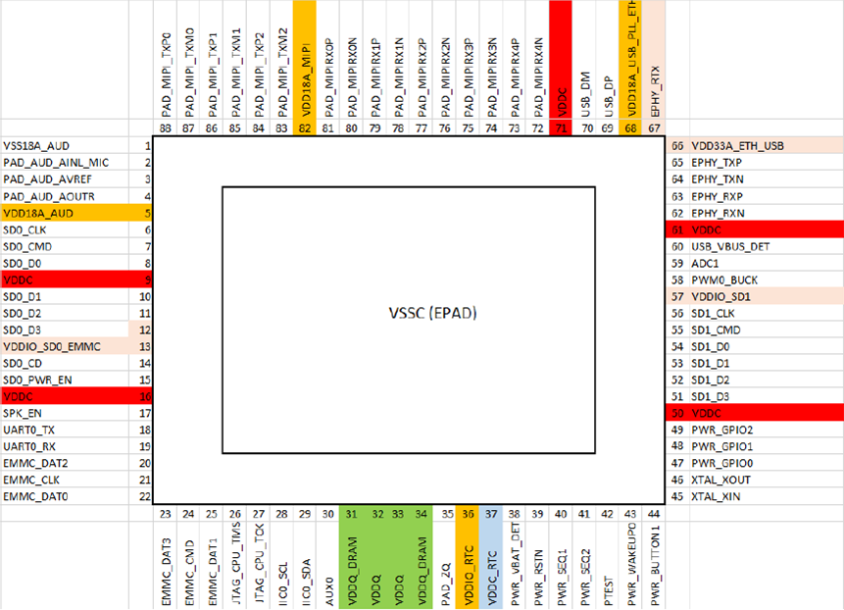
QFN Ball Map
MIPI
USB
EPHY
AUD
SDIO
SDIO
EMMC
DDR

Slide 9
Stackup
QFN PKG: SG2002

Slide 10
PCB 4-Layer Stackup
叠构层数: 4层
叠构厚度: 1mm +/-10% <=厚度 <=1.6mm +/-10%
每层Cu采用1oz.
介电层厚度限制:
参考叠构
层号 | 材质 | 厚度限制
L1/L2 | Prepreg | <=5mils (Cu与pp 压合后, pp不含cu厚度)
L3/L4
L2/L3 | Core | >=25mils

Slide 11
DDR 电源绕线 (DDR3_1.5V)
QFN PKG: SG2002
4-Layer PCB (38x38mm2)

Slide 12
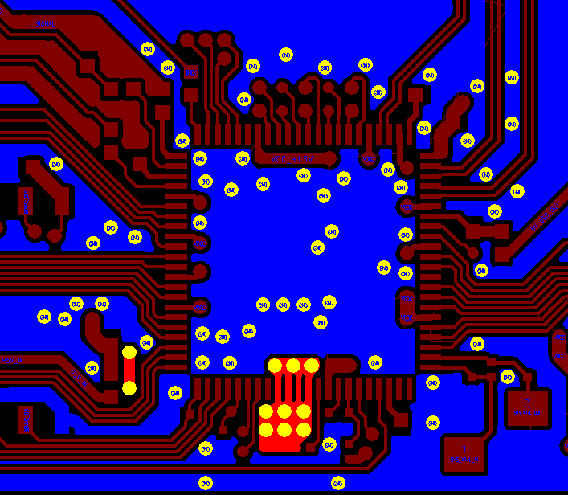
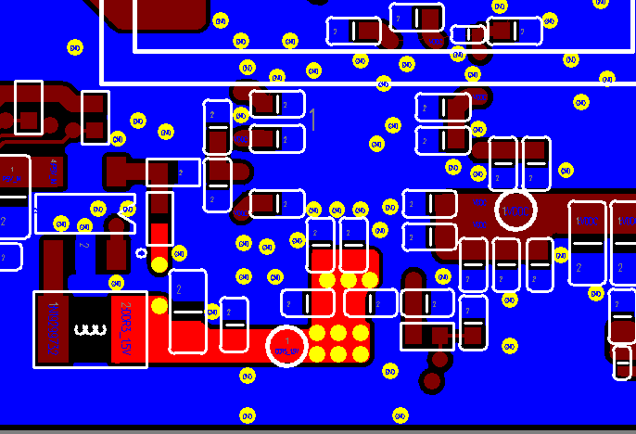
QFN – 4L-PCB DDR Layout
Stackup: (1) GND@L2(shape) (2) DDR3_1.5V@L1/L2 (shape)
DDR3_1.5V@Top
DDR3_1.5V@Bottom
4-Layers Stackup
pp
L1 GND
L2 : GND
Core
SOC
pp
L3
L4 : DDR3_1.5V
PMIC

Slide 13
QFN - 4L-PCB - DDR3_1.5V - Rule 1
Power | Layer | SOC VIA count | Layout rule
DDR3_1.5V | Top | (1) @E-pad 7.6x7.6mm2区域: VIA 数量: 3 (2) pin out区域: VIA 数量: 6 | (1) 覆盖Solder mask区域: E-pad 7.6x7.6mm2 (2) 非覆盖Solder mask区域: E-pad 6x6mm2 (3) 确认DDR3_1.5V SOC 端VIA数量
DDR3_1.5V@Top
E-pad aera 7.6x7.6mm2 (solider mask)
SOC
E-pad aera 6x6mm2 (uncover solider mask)
pin out区域

Slide 14
QFN - 4L-PCB DDR3 – DDR3_1.5V - Rule 2
Power | Layer | Layout rule
DDR3_1.5V | Bottom | DDR3_1.5V main route, (1) 确认SOC处有下9颗VIA (2) 尺寸要求: 1) W1>=1.5mm 2) L1<=10mm, , 扣除破孔有效宽度: W2>=1mm (板形<=38x38mm2) 3) L1>10mm, 扣除破孔有效宽度: W2>=1.5mm (板形>38x38mm2)
DDR3_1.5V@Top
DDR3_1.5V@Bottom
SOC
PMIC
W1
W2
L1

Slide 15

QFN - 4L-PCB - DDR3Q_1.5V - Rule 3
Power | Layer | DeCap@Dram area | Layout rule
DDR3Q_1.5V | Top/Bottom | DDR3Q_1.5V@Bottom: (1) 0402 0.1uF: C2 /C4 (2) 0402 1uF: C1 (3) 0402 4.7uF: C3/C5 (4) 0603 10uF: C6 | (1) DDR3_1.5V VIA rule E-pad 区域 3 颗via紧连C1/C2/C3 Pin-out 区域 6颗 via紧连C4/C5/C6/C7 (1) GND VIA rule 确认每颗Cap旁至少1颗GND via
DDR3_1.5V@Top
DDR3_1.5V@Bottom
C1
C2
E-pad 区域:3 vias
C3
C4
C6
C5
Pin-out 区域:6 vias

Slide 16
Serdes 讯号绕线
QFN PKG: SG2002
4-Layer

Slide 17
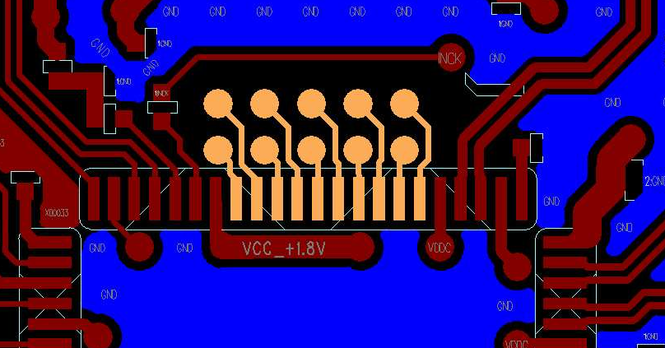
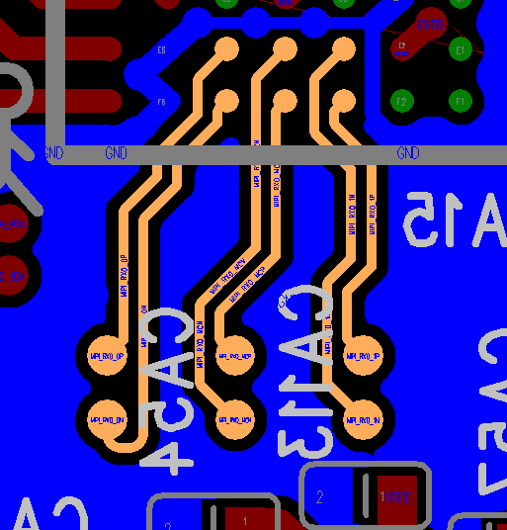
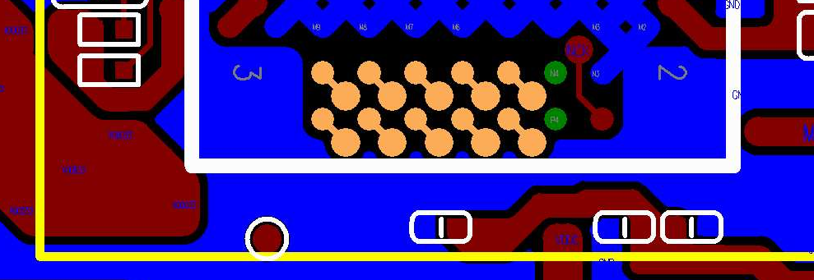
QFN 4L-PCB – MIPI Routing – 表层走线
NO GND shielding
P
P
N
Signal | Layer | Zo | Shielding Rule | Trace width/spacing (mm)
MIPI RX Diff pair | Top/ Bottom | 100 ohm | (1) Routing length L1<=3.5mm NO GND shielding | (1) 0.125/0.1(W/S) (2) Ds>=0.2 (lane to lane spacing)
 |  |  | (2) Routing length L1>3.5mm Lane to lane shielding | 0.125/0.125/0.125 (W/S/Dg)
N
G
Core
W
S
W
Ds
W
S
W
GND
Lane to lane shielding
G
P
N
G
Core
Dg
W
S
W
Dg
GND
Routing length<=3.5mm, QFN MIPI RX@Top
Routing length>=3.5mm, QFN MIPI RX@Bottom
Routing length<=3.5mm, QFN MIPI RX@Bottom
L1

Slide 18
MIPI Routing – Length Matching Rule
Signal | Matching Reference | Matching Length
TX | inter skew | <=2.5mm (100mils)
RX | inter skew
TX | P/N intra skew | <=0.5mm (20mils)
RX | P/N intra skew

Slide 19
QFN – 4L-PCB – USB Routing – 表层走线- Rule
Signal | Layer | Zo | Trace width/spacing (mm) | Shielding Rule
USB Diff pair | Top/ Bottom | 90ohm | 0.125/0.1/0.15 (W/S/D) | Lane to lane GND shielding. Shielding GND VIA: Lane to Lane GND shielding必须下VIA (VIA to VIA 距离<=7.5mm)
USB Diff pair
D
W
S
W
D
Shielding GND VIA
GND
G
P
N
G
S1
Diff P/N
GND
pp
GND

Slide 20
USB Routing – Length Matching Rule
Signal | Matching Reference | Matching Length
USB_DM USB_DP | P/N intra skew | <=0.5mm (20mils)

Slide 21
QFN – 4L-PCB - EPHY Routing – 表层走线 – 线长<=40mm
Signal | Layer | Zo | Trace width/spacing (mm) | Shielding Rule
EPHY TX/RX Diff pair | Top | 100ohm | 0.125/0.125/0.15 (W/S/D) | Lane to lane GND shielding. Shielding GND VIA: Lane to Lane GND shielding必须下VIA (VIA to VIA 距离 S1<=7.5mm)
EPHY TX/RX
D
W
S
W
D
Shielding GND VIA
G
P
N
G
GND
S1
Diff P/N
pp
GND
GND

Slide 22
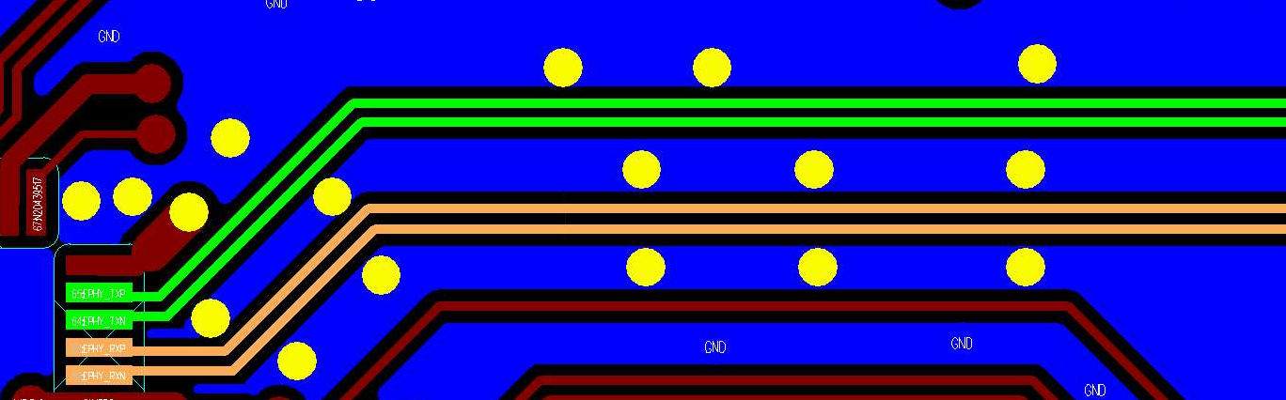
QFN 4L-PCB EPHY Routing –表层走线 – 线长<=40mm
Signal | Layer | Requirement | Layout Rule
EPHY TX/RX | Top | TX to RX GND shielding | 确认TX/RX GND shielding至pin/ball 端
QFN EPHY TX/RX differential@L1
EPHY_TX
EPHY_RX
TX/RX GND shielding
至pin 端

Slide 23
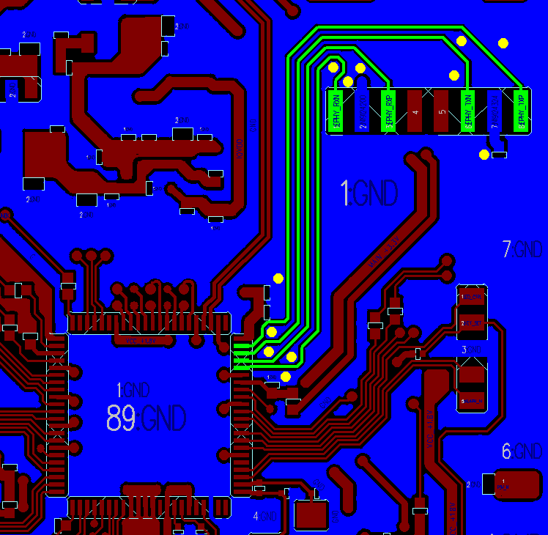
QFN – 4L-PCB - EPHY Routing –表层走线 – 线长>40mm
Signal | Layer | Zo | Trace width/spacing (mm) | Shielding Rule
EPHY TX/RX P/N rout | Top | No control | 0.125/0.125/0.125 (Ws/Sg/Wg) | P/N 之间须有GND trace shielding TX/RX 之间须有GND trace shielding GND trace VIA rule: 1) 需确认靠近SOC端的GND trace 至少有一颗VIA与SOC PKG E-pad构成回路 2) 需确认靠近transformer端的GND trace至少有一颗VIA与transformer GND pin构成回路
Shielding GND VIA
EPHY TX/RX
Transformer
Wg
Sg
Ws
Sg
Wg
Sg
Ws
Sg
Wg
TX
GND 回流VIA
G
P
G
N
G
G
RX
pp
GND
SOC
E-PAD
GND
GND 回流VIA

Slide 24
QFN 4L-PCB EPHY Routing –表层走线 – 线长>40mm
Signal | Layer | Requirement | Layout Rule
EPHY TX/RX | Top | TX to RX GND shielding 0.125/0.125 (Wg/Sg) | GND trace VIA rule: 1) 需确认靠近SOC端的GND trace 至少有一颗VIA与SOC PKG E-pad构成回路 2) 需确认靠近transformer端的GND trace至少有一颗VIA与transformer GND pin构成回路
EPHY TX/RX Isolation
TX
Sg
Wg
Sg
RX
G
P
G
N
P
G
N
G
G
G
pp
GND

Slide 25
EPHY Routing – Length Matching Rule
Signal | Matching Reference | Matching Length
EPHY TX/RX Diff pair | P/N intra skew | <=0.5mm (20mils)

Slide 26
Single-end 讯号绕线
QFN PKG: SG2002
4-Layer

Slide 27
QFN – 4L-PCB - Single-end – Rule
Signal | Layer | Shielding Rule | Trace width/spacing (mm)
SDIO RTC | 4L-PCB: Top/Bottom | Break out (fan-out) region: NO GND trace shielding, ref GND plane | W>=0.1 0.1/0.1 (S/D) (0.1mm spacing)
 |  | Main rout: NO GND trace shielding, ref GND plane | W>=0.1 0.15/0.1 (S/D) (0.15mm spacing)
NO GND trace shielding
G
S
S
S
…
S
G
pp
D
W
S
W
S
W
W
D
GND

Slide 28
QFN – 4L-PCB – EMMC – Rule
Signal | Layer | Shielding Rule | Trace width/spacing (mm)
EMMC | Top | Break out (fan-out) region: NO GND trace shielding, ref GND plane | (1) W>=0.1 (2) 0.1/0.1 (S/D) (0.1mm spacing)
 |  | Main rout: NO GND trace shielding, ref GND plane | W>=0.1 0.15/0.1 (S/D) (0.15mm spacing)
NO GND trace shielding
G
S
S
S
…
S
G
pp
D
W
S
W
S
W
W
D
GND

Slide 29
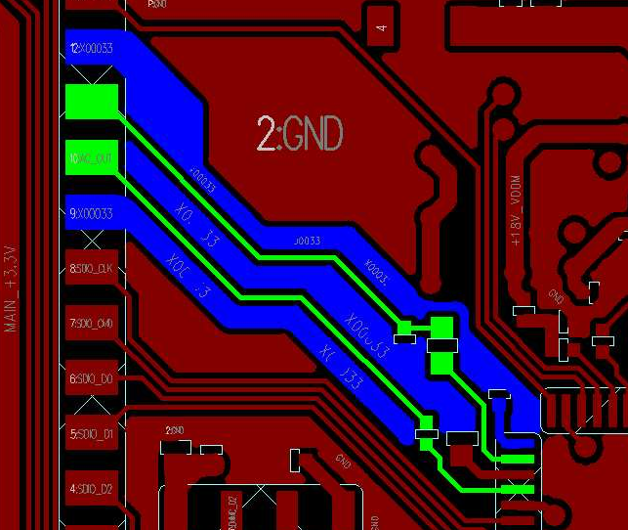
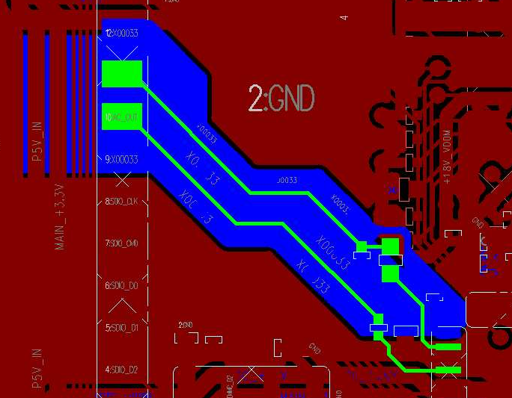
QFN 4L-PCB – AUD – Rule
Per trace shielding
Signal | Layer | Shielding Rule | Trace width/spacing (mm)
AUD_MIC_L AADC_AIN_MIC1 AUD_OUT | Top | (1) per trace shielding (2) ref AUD GND plane (3) 确认AUD 讯号线下方有 完整AUD GND plane | W>=0.1 D=0.1
G
S
G
D
W
D
Core
GND
AUD@Top
AUD@L1/L2
AUD GND
AUD GND
AUD GND
pin

Slide 30
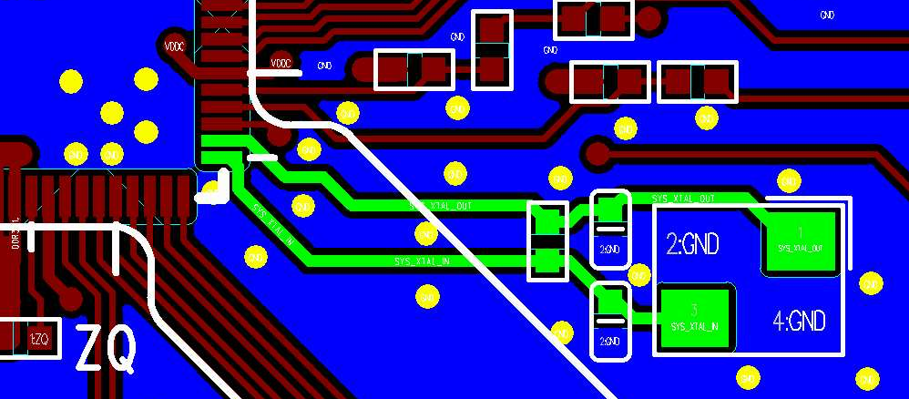
QFN – 4L-PCB – XTAL_IN/OUT - Rule
Signal | Layer | Shielding Rule | Trace width/spacing (mm)
SYS_XTAL_IN SYS_XTAL_OUT | Top | per trace shielding ref GND plane | 0.25/0.25 (W/D)
Per trace shielding
G
S
G
pp
D
W
D
GND
QFN XTAL@Top

Slide 31
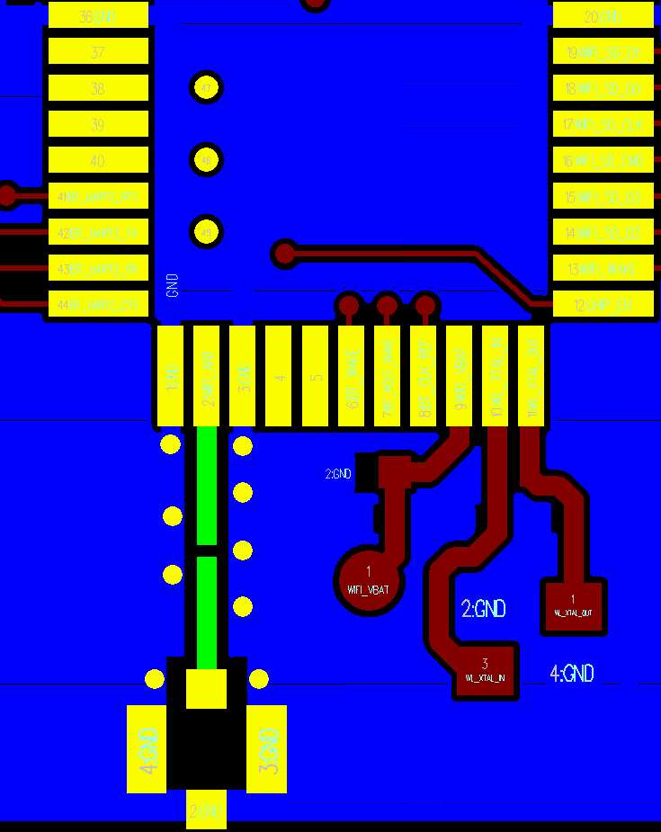
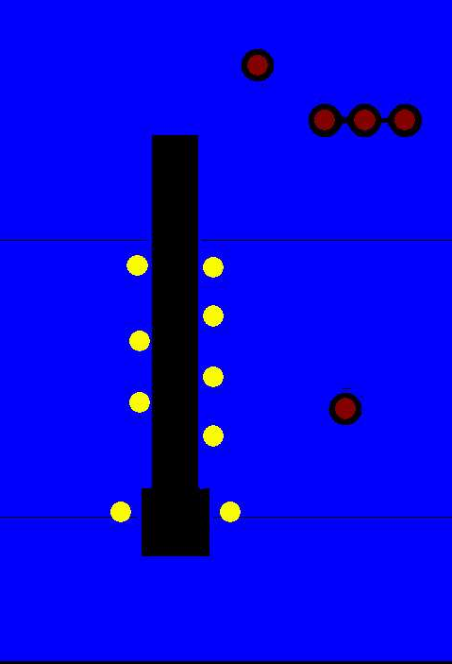
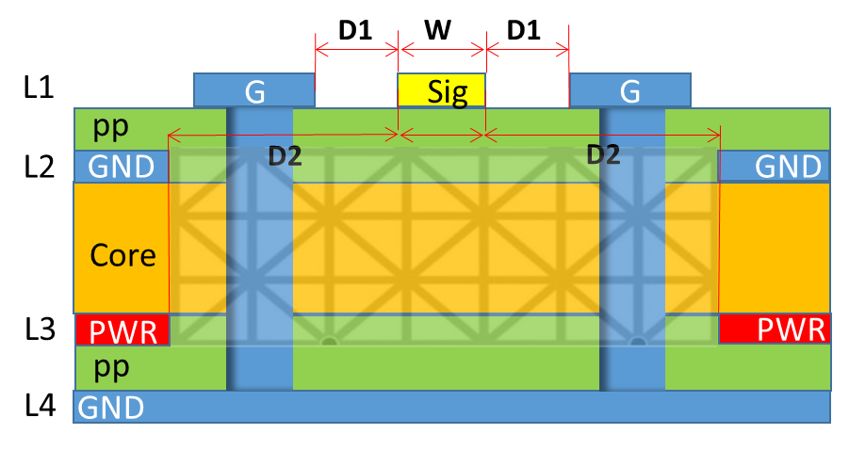
QFN – 4L-PCB – WIFI_ANT Layout Rule
Signal | Layer | Zo | Shielding Rule | Trace width/spacing (mm)
WIFI_ANT | Top | 50ohm | Per trace shielding | 0.75/0.15/0.3 (W/D1/D2)
WIFI_ANT@Top
WIFI_ANT@GND/PWR plane
4L-PCB
WIFI_ANT 下方plane
需挖空
WIFI_ANT

Slide 32
模拟/数字电源绕线
QFN PKG: SG2002
4-Layer

Slide 33
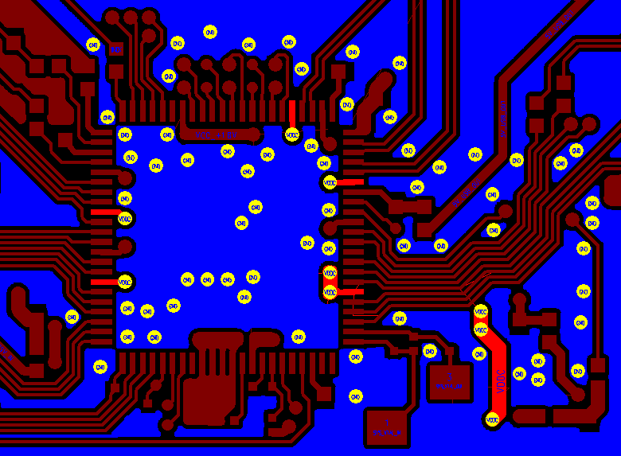
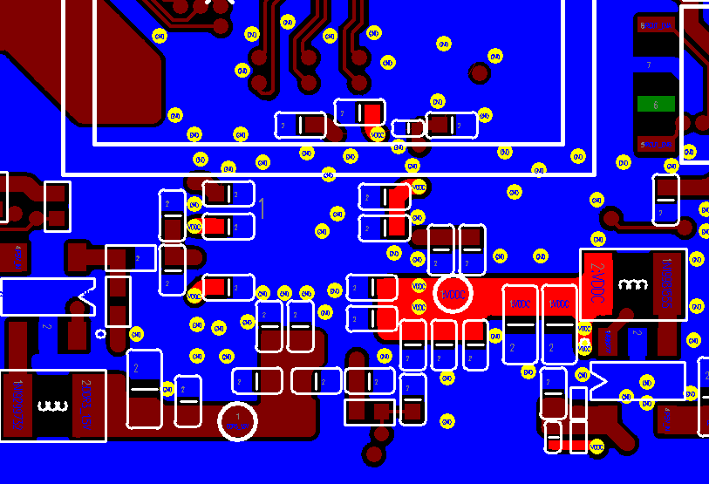
QFN – 4L-PCB – VDDC – Rule 1
Power | Layer | SOC VIA count | DeCap | Layout rule
VDDC | Top/Bottom | 5 | (1) 0402 0.1uF: C1/C6/C7 (2) 0402 1uF: C2/C3/C5 (3) 0402 4.7uF: C4/C8 (4) 0603 10uF: C9/C10 | VDDC VIA rule 每根VDDC pin 需连接1颗VIA (2) GND VIA rule 确认每颗Cap旁至少1颗GND via
VDDC@Top
VDDC@Bottom
C1
SOC
C7
SOC
C2
C6
C3
C4
C5
C8
C9
C10
PMIC

Slide 34
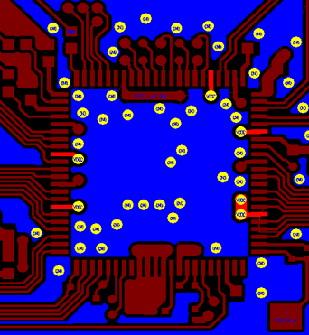
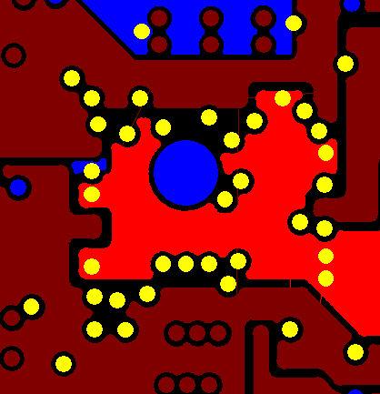
QFN – 4L-PCB - VDDC – Rule 2
Power | Layer | Layout rule
VDDC | L3/Bottom | DDR3_1.5V 内层绕线; (1) 确认SOC处5颗VIA (2) SOC区域尺寸: 1) SOC QFN正下方,扣除破孔有效宽度: W1>=1mm 2) L1<=10mm,扣除破孔有效宽度: W2>=1.2mm (进入SOC 区域, 板形<=38x38mm2) 3) L1>10mm,扣除破孔有效宽度: W2>=1.5mm (进入SOC 区域, 板形>38x38mm2)
VDDC@Top
VDDC@L3
VDDC@Bottom
SOC处5颗VIA
SOC
SOC
SOC
W2
W1
PMIC
L1

Slide 35
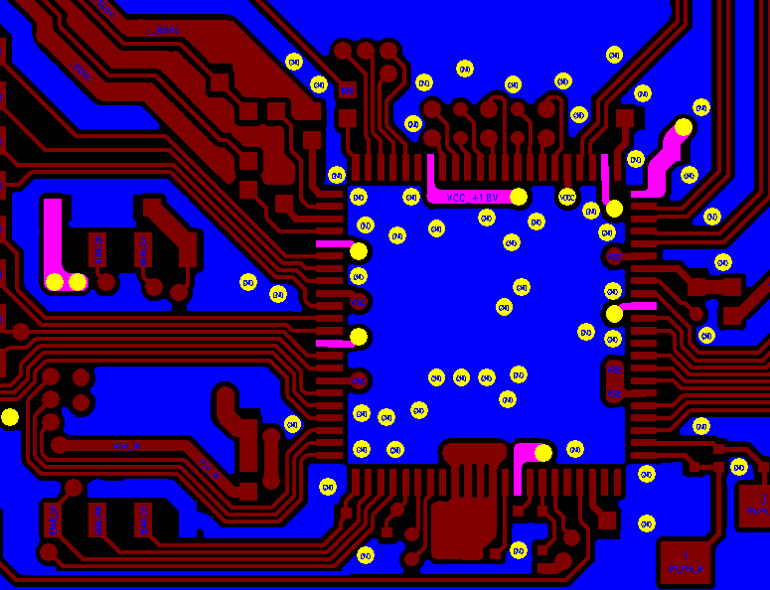
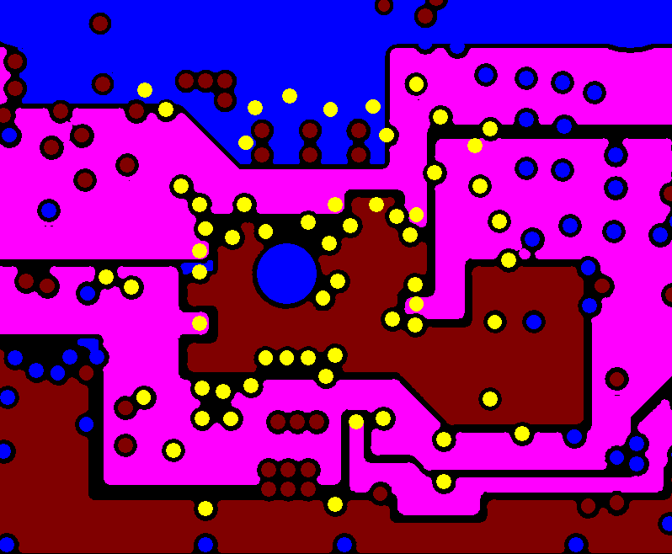
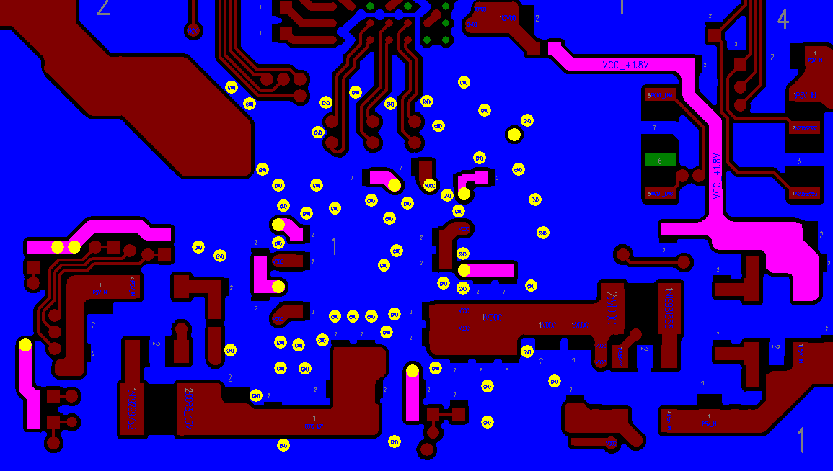
QFN – 4L-PCB – Analog IO Power – Rule 1
Power | Layer | Layout rule
VDDC_+1.8V Main_+3.3V | L1/L3/L4 | @Top: (1) SoC下方:线宽 W1>=0.4mm (2) SoC以外:线宽 W2>=0.5mm @L3/Bottom:所有线宽 W3>=0.5mm
Analog IO power@Top
Analog IO power@内层
Analog IO power@Bottom
W3
W3
W1
SOC
SOC
W2
SOC

Slide 36
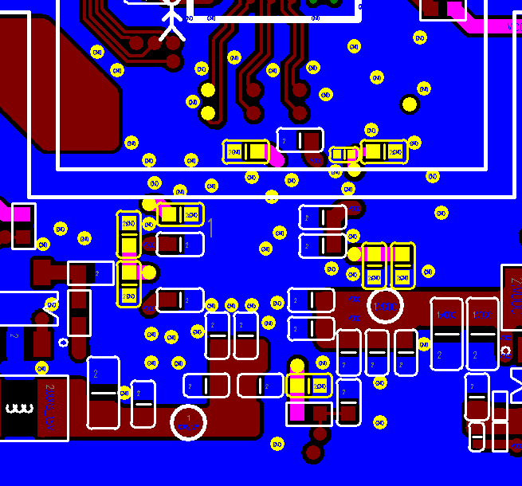
QFN – 4L-PCB - Analog IO Power – Rule 2
Power | Layer | Layout rule
VDDC_+1.8V Main_+3.3V | L1/L3/L4 | (1) Analog IO power VIA rule 每根VDDC pin 需连接1颗VIA (2) GND VIA rule 确认每颗Cap旁至少1颗GND via
Analog IO power@Top
Analog IO power@Bottom
SOC
SOC

Slide 37
Appendix

Slide 38
MIPI/EPHY/USB/Antenna 阻抗控制
4-layer PCB

Slide 39
MIPI/EPHY/USB 阻抗控制 –表层走线 Option1
Layer | Target Z (ohm) | W (mils) | S (mils) | D (mils) | Estimated Z (ohm)
Top/Bottom | 100 | 5 | 5 | 6 | 97.99
 | 90 | 5 | 4 | 6 | 92.48
MIPI/USB differential signals are required impedance control - Target impedance: (1) MIPI- CSI/DSI: 100ohm (2)USB: 90ohm
Differential signals shielding rule:
- pair to pair GND shielding
D
W
S
W
D
G
P
N
G
pp
GND

Slide 40
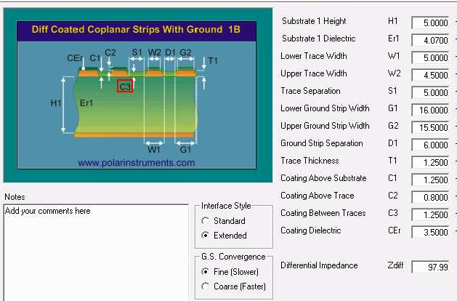
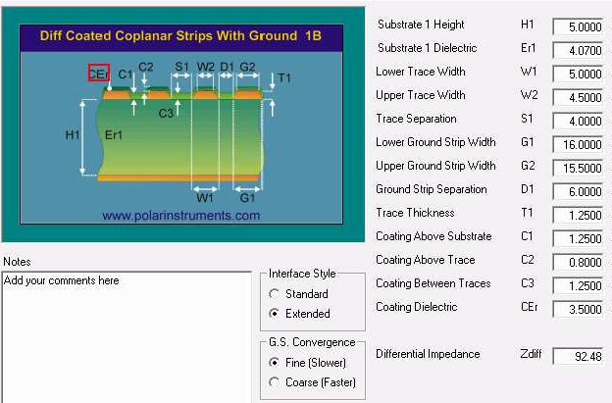
MIPI/EPHY/USB 阻抗控制 –表层走线 Option1
Target Z (ohm) | W (mils) | S (mils) | D (mils) | Estimated Z (ohm)
100 +/- 5% | 5 | 5 | 6 | 97.99
Target Z | W (mils) | S (mils) | D (mils) | Estimated Z (ohm)
90 +/- 5% | 5 | 4 | 6 | 92.48

Slide 41
MIPI 阻抗控制 – 表层走线 Option2
Layer | Target Z (ohm) | W (mils) | S (mils) | Ds (mils) | Dg (mils) | Estimated Z (ohm) | Rule
Top/Bottom | 100 | 5 | 5 | 12 | 12 | 99.96 | Ds=3W, Dg=3W
G
P
N
P
N
G
pp
Dg
W
S
W
Ds
W
S
W
Dg
GND

Slide 42
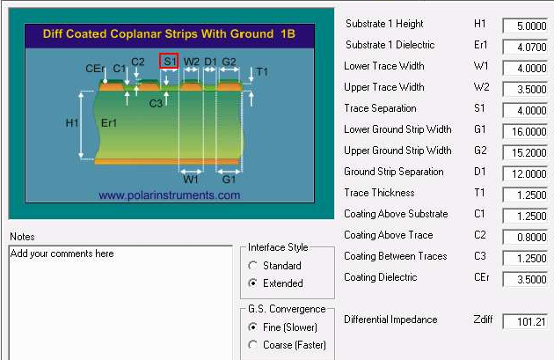

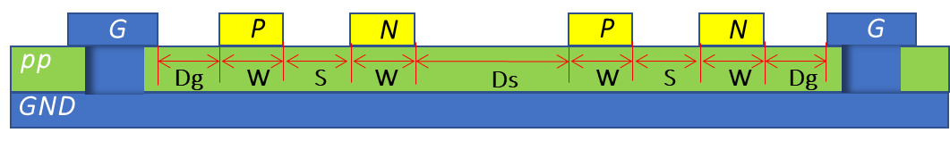
MIPI 阻抗控制 – 表层走线 Option2
Target Z (ohm) | W (mils) | S (mils) | Ds (mils) | Dg (mils) | Estimated Z (ohm)
100 +/- 5% | 5 | 5 | 12 | 12 | 99.96
 | 4 | 4 | 12 | 12 | 101.21

Slide 43
MIPI 阻抗控制 – 内层走线
Layer | Target Z (ohm) | W (mils) | S (mils) | Ds (mils) | Dg (mils) | Estimated Z (ohm)
L2/L3 | 100 | 5 | 10 | 12 | 12 | 98.93
GND
pp
G
P
N
P
N
G
Dg
W
S
W
Ds
W
S
W
Dg
Core
GND

Slide 44
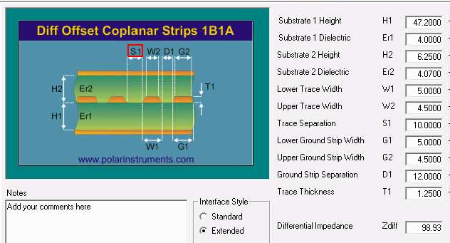
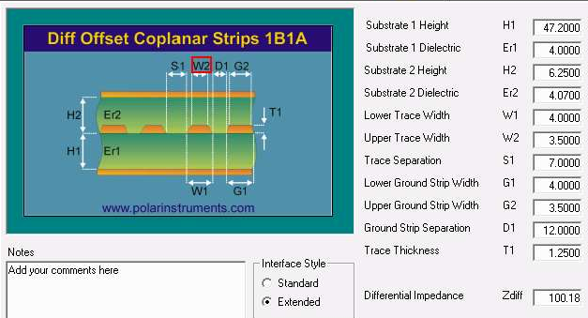
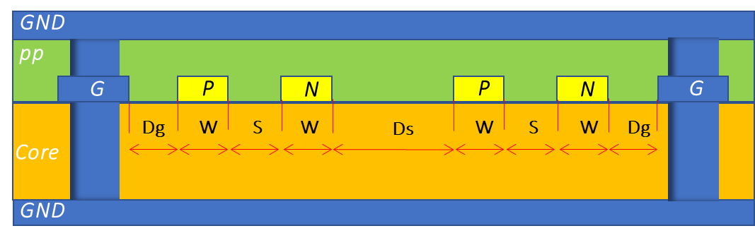
MIPI 阻抗控制 – 内层走线
Target Z (ohm) | W (mils) | S (mils) | Ds (mils) | Dg (mils) | Estimated Z (ohm)
100 +/- 5% | 5 | 10 | 12 | 12 | 98.93
 | 4 | 7 | 12 | 12 | 100.18

Slide 45
EPHY/USB 阻抗控制 – 内层走线
Layer | Target Z (ohm) | W (mils) | S (mils) | D (mils) | Estimated Z (ohm)
L2/L3 | 100 | 5 | 10 | 12 | 98.92
 | 90 | 5 | 7 | 6 | 90.33
GND
D
W
S
W
D
pp
G
P
N
G
Core
GND

Slide 46
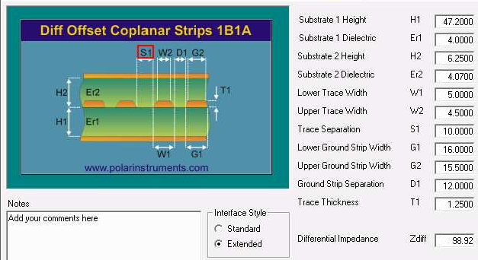
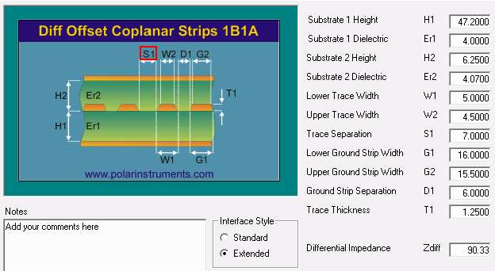
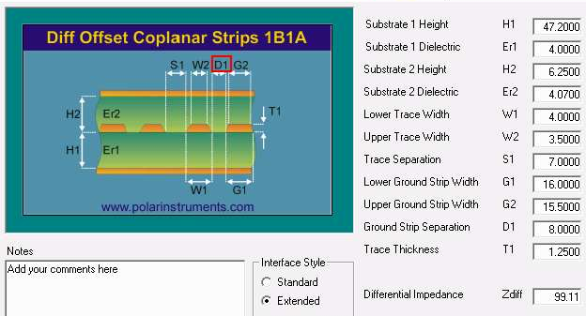

EPHY/USB 阻抗控制 – 内层走线
Target Z (ohm) | W (mils) | S (mils) | D (mils) | Estimated Z (ohm)
100 +/- 5% | 5 | 10 | 12 | 98.92
 | 4 | 7 | 8 | 99.11
Target Z (ohm) | W (mils) | S (mils) | D (mils) | Estimated Z (ohm)
90 +/- 5% | 5 | 7 | 6 | 90.33
 | 4 | 5 | 6 | 90.34

Slide 47
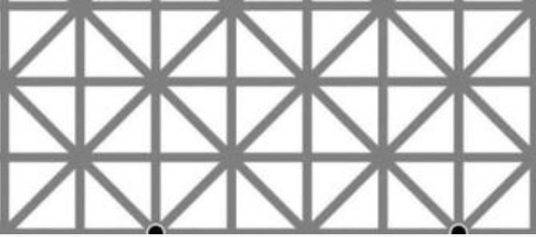
Antenna 50ohm 阻抗控制
Layer | Target Z (ohm) | W (mils) | D1 (mils) | D2(mils) | Estimated Z (ohm) | Note
Top | 50 | 30 | 6 | 12 | 50.93 | Ref layer L4
Layer - Top
D1
W
D1
L1
G
Sig
G
pp
L2
GND
D2
D2
GND
Core
L3
GND
PWR
PWR
pp
L4
GND

Slide 48
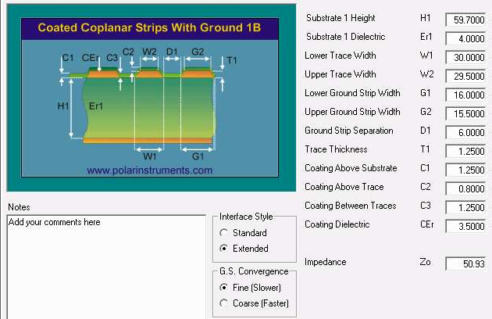
Antenna 50ohm 阻抗控制
Target Z (ohm) | W (mils) | D1 (mils) | D2(mils) | Estimated Z (ohm)
50 +/- 5% | 30 | 6 | 12 | 50.93
D1
W
D1
L1
G
Sig
G
pp
L2
GND
D2
D2
GND
Core
L3
GND
PWR
PWR
pp
L4
GND

